Slide 1


Heuristic Search

Slide 2




Using Evaluation Functions
A General Graph-Searching Algorithm
Algorithm A*
Iterative-Deepening A*
Heuristic Functions and Search Efficiency
Outline

Slide 3
1. Using Evaluation Functions(1/10)
Best-first search (BFS) = Heuristic search
proceeds preferentially using heuristics
Basic idea
Heuristic evaluation function : based on information specific to the problem domain
Expand next that node, n, having the smallest value of
Terminate when the node to be expanded next is a goal node

Slide 4
1. Using Evaluation Functions(2/10)
Example. Eight-puzzle
The number of tiles out of places
----- measure of the goodness of a state description

Slide 5
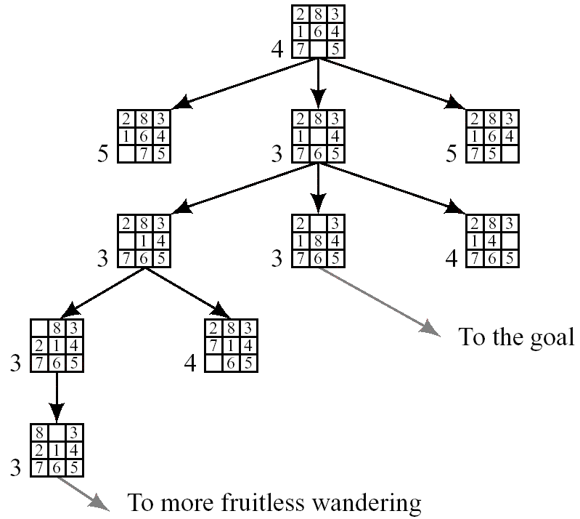
1. Using Evaluation Functions(3/10)
Figure 9.1 A Possible Result of a Heuristic Search Procedure

Slide 6
1. Using Evaluation Functions(4/10)
Preference to early path: add “depth factor” → Figure 9.2

Slide 7
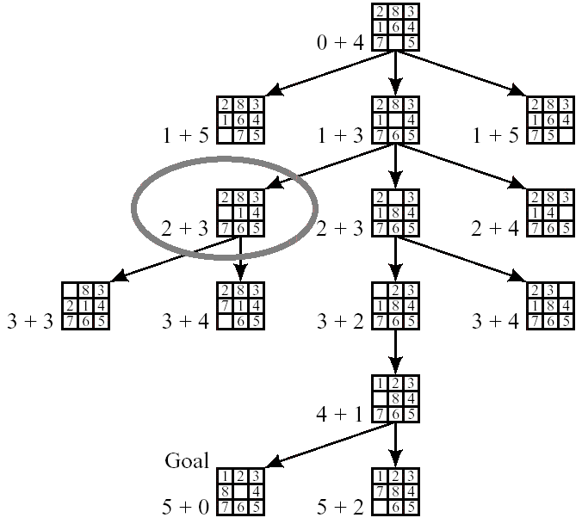
1. Using Evaluation Functions(5/10)

Slide 8
1. Using Evaluation Functions(6/10)
Evaluation function: The sum of the homing steps

Slide 9
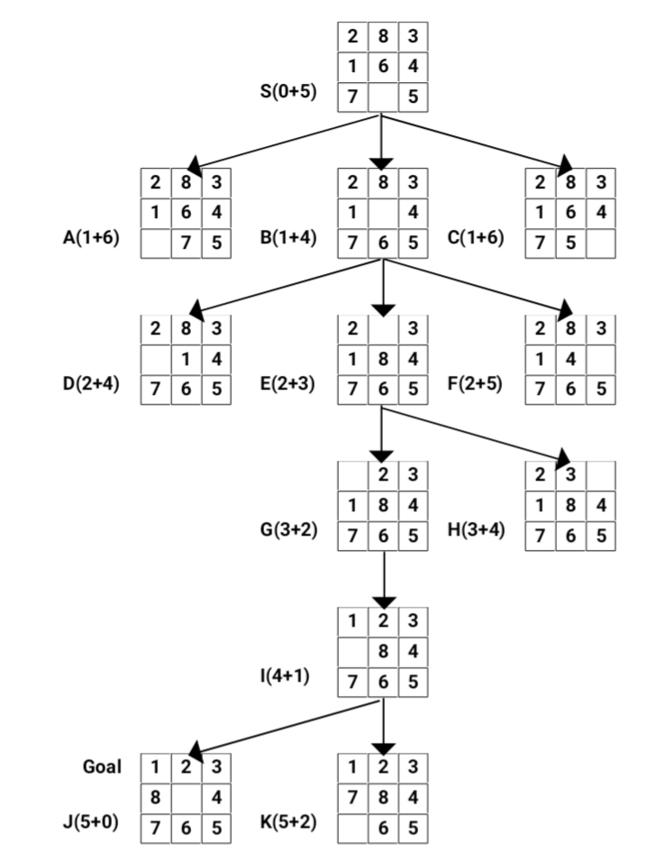

Slide 10
1. Using Evaluation Functions(7/10)
Questions
How to settle on evaluation functions for guiding BFS?
What are some properties of BFS?
Does BFS always result in finding good paths to a goal node?

Slide 11
2. A General Graph-Searching Algorithm
GRAPHSEARCH: general graph-searching algorithm
Create a search tree, Tr, with the start node n₀ → put n₀ on ordered list OPEN
Create empty list CLOSED
If OPEN is empty, exit with failure
Select the first node n on OPEN → remove it → put it on CLOSED
If n is a goal node, exit successfully: obtain solution by tracing a path backward along the arcs from n to n₀ in Tr
Expand n, generating a set M of successors + install M as successors of n by creating arcs from n to each member of M
Reorder the list OPEN: by arbitrary scheme or heuristic merit
Go to step 3

Slide 12
2. A General Graph-Searching Algorithm
Breadth-first search
New nodes are put at the end of OPEN (FIFO)
Nodes are not reordered
Depth-first search
New nodes are put at the beginning of OPEN (LIFO)
Best-first (heuristic) search
OPEN is reordered according to the heuristic merit of the nodes

Slide 13
3. Algorithm A*
Algorithm A*
Reorders the nodes on OPEN according to increasing values of
Some additional notation
h(n): the actual cost of the minimal cost path between n and a goal node
g(n): the cost of a minimal cost path from n₀ to n
f(n) = g(n) + h(n): the cost of a minimal cost path from n₀ to a goal node over all paths via node n
f(n₀ ) = h(n₀ ): the cost of a minimal cost path from n₀ to a goal node
: estimate of h(n)
: the cost of the lowest-cost path found by A* so far to n

Slide 14
3. Algorithm A*
Algorithm A*
If = 0: uniform-cost search
When the graph being searched is not a tree?
more than one sequence of actions that can lead to the same world state from the starting state
In 8-puzzle problem
Actions are reversible: implicit graph is not a tree
Ignore loops in creating 8-puzzle search tree: don’t include the parent of a node among its successors
Step 6
Expand n, generating a set M of successors that are not already parents (ancestors) of n + install M as successors of n by creating arcs from n to each member of M

Slide 15
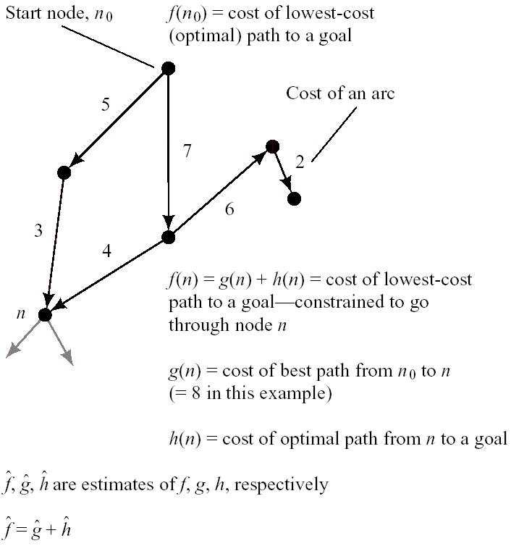
Figure 9.3 Heuristic Search Notation

Slide 16
3. Algorithm A*
Modification of A* to prevent duplicate search effort
G
search graph generated by A*
structure of nodes and arcs generated by A*
Tr
subgraph of G
tree of best (minimal cost) paths
Keep the search graph
subsequent search may find shorter paths
the paths use some of the arcs in the earlier search graph, not in the earlier search tree

Slide 17
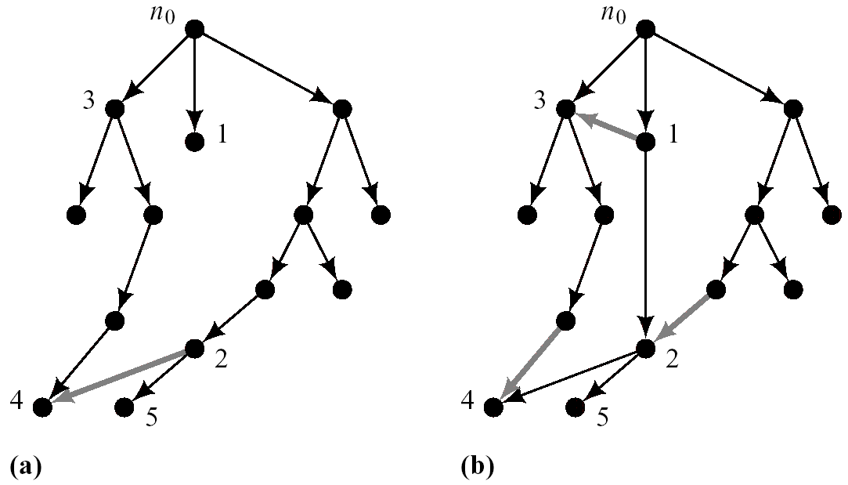
Figure 9.4 Search Graphs and Trees Produced by a Search Procedure

Slide 18
3. Algorithm A*
A* that maintains the search graph
Create a search graph, G, consisting solely of the start node, n₀ → put n₀ on a list OPEN
Create a list CLOSED: initially empty
If OPEN is empty, exit with failure
Select the first node on OPEN → remove it from OPEN → put it on CLOSED: node n
If n is a goal node, exit successfully: obtain solution by tracing a path along the pointers from n to n₀ in G
Expand node n, generating the set, M, of its successors that are not already ancestors of n in G →install these members of M as successors of n in G

Slide 19
3. Algorithm A*
Establish a pointer to n from each of those members of M that were not already in G → add these members of M to OPEN
→ for each member, m, redirect its pointer to n if the best path to m found so far is through n → for each member of M already on CLOSED, redirect the pointers of each of its descendants in G
Reorder the list OPEN in order of increasing values
Go to step 3
Redirecting pointers of descendants of nodes
Save subsequent search effort

Slide 20
 | OPEN | CLOSED
 | ( S) | ( )
1 | ( BAC) | (S)
2 | (DEACF) | (SB)
3 | (EACFGH) | (SBD)
4 | (IACFGHJ) | (SBDE)
5 | (KACFGHJ) | (SBDEI)
6 | (LACFGHJM) | (SBDEIK)
7 | L goal state | (SBDEIKL)

Slide 21
3. Algorithm A* (Admissibility)
Conditions that guarantee A* always finds minimal cost paths
Each node in the graph has a finite number of successors
All arcs in the graph have costs greater than some positive amount ε
For all nodes in the search graph,
Theorem 9.1
Under the conditions on graphs and on , and providing there is a path with finite cost from n₀ to a goal node, algorithm A* is guaranteed to terminate with a minimal-cost path to a goal

Slide 22
3. Algorithm A* (Admissibility)
Lemma 9.1
At every step before termination of A*, there is always a node, n*, on OPEN with the following properties
n* is on an optimal path to a goal
A* has found an optimal path to n*
Proof : by mathematical induction
Base case
at the beginning of search, n₀ is on OPEN and on an optimal path to the goal
A* has found this path
n₀ : n* of the lemma at this stage

Slide 23
3. Algorithm A* (Admissibility)
Induction step
assume the conclusions of the lemma at the time m nodes have been expanded ( )
prove the conclusions true at the time m+1 nodes have been expanded
Continuing the proof of the theorem
A* must terminate
A* terminates in an optimal path
Admissible
Algorithm that is guaranteed to find an optimal path to the goal
With the 3 conditions of the theorem, A* is admissible
Any function not overestimating h is admissible

Slide 24
3. Algorithm A* (Admissibility)
Theorem 9.2
If is more informed than , then at the termination of their searches on any graph having a path from n₀ to a goal node, every node expanded by is also expanded by
expands at least as many nodes as does
is more efficient
Figure 9.6
: uniform-cost search
: breadth-first search
uniform-cost/breadth-first search: admissible

Slide 25
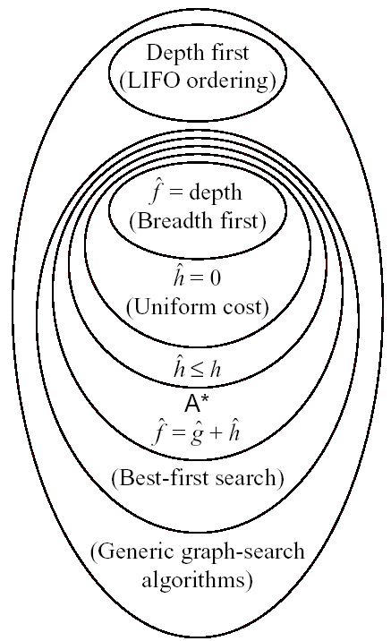
Figure 9.6 Relationships Among Search Algorithm

Slide 26
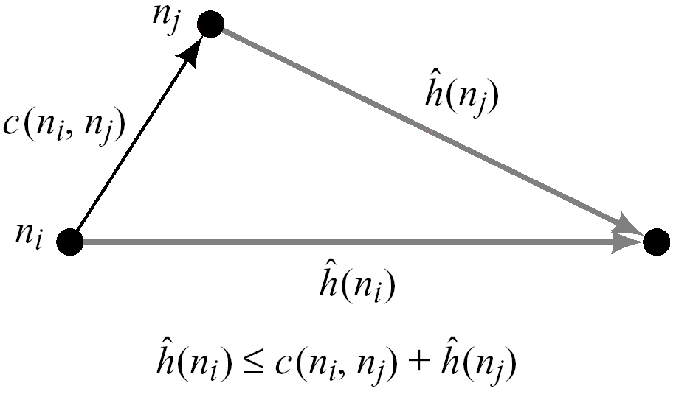
3.The Consistency (or Monotone) Condition
Consistency condition
n_{j} is a successor of n_{i}
: cost of the arc from n_{i} to n_{j}
Rewriting
A type of triangle inequality

Slide 27
3 The Consistency Condition
Implies that values of the nodes are monotonically nondecreasing as we move away from the start node
Consistency condition on is often called the monotone condition on
Theorem 9.3
If the consistency condition on is satisfied, then when A* expands a node n, it has already found an optimal path to n

Slide 28
3 The Consistency Condition
Argument for the admissibility of A* under the consistency condition
Monotonicity of : search expands outward along contours of increasing values
The first goal node selected will be a goal node having a minimal
For any goal node, n_{g},
The first goal node selected will be one having minimal
Whenever a goal node, n_{g}, is selected for expansion, we have found an optimal path to that goal node ( )
The first goal node selected will be one for which the algorithm has found an optimal path

Slide 29
4. Iterative-Deepening A*
Breadth-first search
Exponentially growing memory requirements
Iterative deepening search
Memory grows linearly with the depth of the goal
Parallel implementation of IDA*: further efficiencies gain
IDA*
Cost cut off in the first search:
Depth-first search with backtracking
If the search terminates at a goal node: minimal-cost path
Otherwise
increase the cut-off value and start another search
The lowest values of the nodes visited (not expanded) in the previous search is used as the new cut-off value in the next search

Slide 30
5. Recursive Best-First Search
RBFS (recursive best-first search)
uses slightly more memory than does IDA*
generates fewer nodes than does IDA*
Backing up value
When a node n is expanded, computes values of successors of n and recomputes values of n and all of n’s ancestors
Process of backing up
Backed-up value, , of node m with successors

Slide 31
5. Recursive Best-First Search
Description
One of successors of node n has the smallest over all OPEN nodes, it is expanded in turn, and so on.
When other OPEN node, n’, (not a successor of n) has the lowest value of
backtracks to the lowest common ancestor, node k
k_{n}: successor of node k on the path to n
RBFS removes the subtree rooted at k_{n}, from OPEN
k_{n} becomes an OPEN node with value (its backed-up value)
Search continues below that OPEN node with the lowest value of

Slide 32
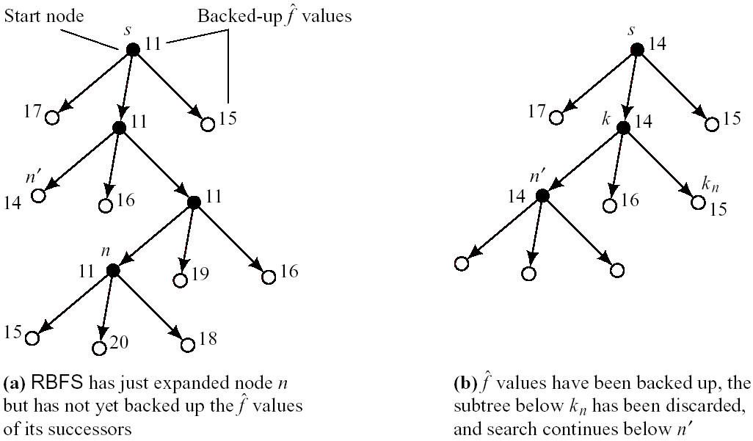
Figure 9.9 Recursive Best-First Search

Slide 33
6. Heuristic Functions and Search Efficiency
Selection of heuristic function
Crucial for the efficiency of A*
assures admissibility
Uniform-cost search → inefficient
= the highest possible lower bound on h
maintains admissibility
expands the fewest nodes
Using relaxed model
functions are always admissible

Slide 34
6. Heuristic Functions and Search Efficiency
Selecting function
must consider the amount of effort involved in calculating it
Less relaxed model: better heuristic function (difficult in calculating)
Trade off between the benefits gained by an accurate and the cost of computing it
Using instead of the lower bound of h
increases efficiency at the expense of admissibility
: easier to compute
Modifying the relative weights of and in the evaluation function
Large values of w: overemphasize the heuristic component
Very small values of w: give the search a predominantly breadth-first character

Slide 35
6. Heuristic Functions and Search Efficiency
3 important factors
The cost (or length) of the path found
The number of nodes expanded in finding the path
The computational effort required to compute
Time complexity: O(n)
Breadth-first search: O(B^{d})
Uniform-cost search ( ): O(B^{C/c})
C: cost of an optimal solution
c: cost of the least costly arc

Slide 36
Additional Readings

